Slide 1
DEEPFAKE FACE DETECTION
1

Slide 2

PROJECT VIVA-VOCE PRESENTATION ON
DEEPFAKE FACE DETECTION
Submitted by
M. MURALI KRISHNA
Reg. No : 322203320038
Under the guidance of
Dr. N . Jaya Lakshmi
Associate Professor
DEPARTMENT OF COMPUTER APPLICATIONS
GAYATRI VIDYA PARISHAD COLLEGE OF ENGINEERING (AUTONOMOUS)
(Affiliated to J.N.T. University, Kakinada, A.P)
2022-2024
2

Slide 3
DRC STATUS
DRC | STATUS | DATE
DRC-0 | Completed | 05/01/2024
DRC-1 | Completed | 02/02/2024
DRC-2 | Completed | 23/04/2024
CRC | Completed | 02/05/2024
3

Slide 4
OUTLINES OF THE PRESENTATION
ABSTRACT
PROBLEM STATEMENT
LITERATURE SURVEY
EXISTING SYSTEM
PROPOSED SYSTEM
SYSTEM REQUIREMENTS
SYSTEM ARCHITECTURE
FLOW CHART
USE CASE DIAGRAMS
ALGORITHM
SAMPLE CODES
WEBPAGE PREVIEW
UPLOADED PAGE
OUTPUTS SCREEN
CONCLUSION
FUTURE SCOPE
REFERENCES
4

Slide 5
ABSTRACT
Deepfake videos are manipulated videos that use advanced artificial intelligence and machine learning techniques to create a fake video that looks very realistic. Deepfake videos has become a growing concern in various domains, including politics, entertainment, and cybersecurity. These videos can be used to spread fake information and cause public tension. In response to this challenge, this project proposes a robust deepfake detection system that utilizes the power of Inception V3 and Gated Recurrent Unit (GRU) algorithms . This technique involves the training to identify the most relevant features of a video and then using these features to detect manipulations. Inception V3 Convolution neural network to extract frame-level features, which are then used to train a GRU-based model to classify videos as real or manipulated. The GRU model achieves 80% accuracy in classifying videos as real or manipulated.
5

Slide 6
PROBLEM STATEMENT
The rise of deepfake videos is a serious threat in the world . Deep Fake technology, which uses advanced machine learning algorithms to manipulate face in the videos. This technology has the potential to create convincing fake videos, images, and audio recordings that can be used to deceive people and spread misinformation. This has already resulted in political and social media and the problem is expected to worsen in the future. Therefore there is a need for the best solution that can detect and prevent deep fakes from spreading.
6

Slide 7
LITERATURE SURVEY
Peipeng Yu & Zhihua Xia, conducted a review that aims to demonstrate the current research status of deepfake video detection, especially, generation process, several detection methods and existing benchmarks. It has been revealed that current detection methods are still insufficient to be applied in real scenes, and further research should pay more attention to the generalization and robustness.
Yang et al. (2020), proposed a method of training a confrontational Deepfake model will contribute to a significant deterioration in the quality of the synthesized images.
G¨uera and Delp, explored the detection of deepfakes using neural network work on the extraction of facial features from the video at the level of frames. These can be improved with the addition of more layers to work on the quality of the video output.
7

Slide 8
EXISTING SYSTEM
Existing systems for deepfake detection might include traditional approaches such as rule-based systems, basic video analysis techniques, Face Recognition techniques. These methods might lack the sophistication to effectively detect increasingly realistic deepfake videos generated by advanced AI and machine learning techniques
8

Slide 9
PROPOSED SYSTEM
The proposed system, utilizing Inception V3 and GRU(Gated Recurrent Unit), represents an advancement over traditional methods. Inception V3 is known for its ability to extract meaningful features from images, and GRU is effective in capturing temporal dependencies in sequences, making them a suitable combination for video analysis.
9

Slide 10
SYSTEM REQUIREMENTS
Software Requirements
Operating System : Windows 11
Script Language : Python 3 or above
IDE : VS Code
Front end :HTML ,CSS , Java Script
Framework :Flask
10

Slide 11
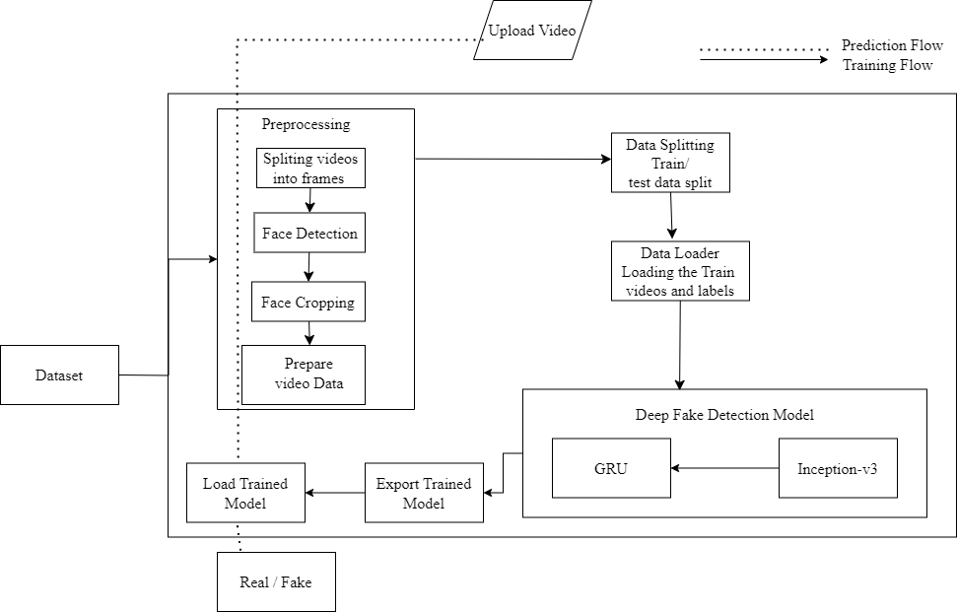
SYSTEM IMPLEMENTATION
11

Slide 12
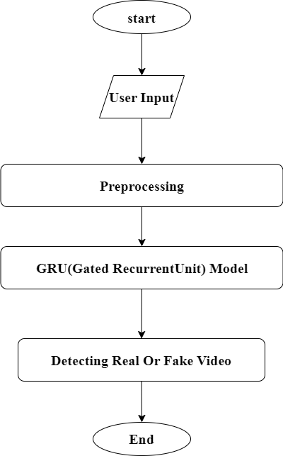
FLOW CHART
12

Slide 13

USE CASE DIAGRAM
Preprocessing video
Prediction
Model
Fake / Real
13

Slide 14
USE CASE DIAGRAM
Upload video
View Output
User
14

Slide 15
ALGORITHM –GRU(Gated Recurrent Unit)
The GRU is a type of recurrent neural network (RNN) architecture designed to address the limitations of traditional RNNs, such as the vanishing gradient problem.
It is particularly effective in modeling sequential data, making it suitable for tasks like time series prediction, natural language processing, and video analysis.
Update Gate: Controls how much of the previous hidden state to retain and how much of the new state to consider.
Reset Gate: Determines how much of the previous state should be ignored in computing the new candidate state.
Candidate Activation: Computes a new candidate state based on the current input and the previous hidden state.
At each time step, the GRU takes an input vector and the previous hidden state as input.
The update gate and reset gate are calculated based on the input and previous hidden state.
Due to their simpler architecture, GRUs are easier to train compared to more complex models.
The Gated Recurrent Unit (GRU) algorithm offers an efficient and effective solution for modeling sequential data, making it a valuable tool for various machine learning tasks, including deepfake detection.
15

Slide 16
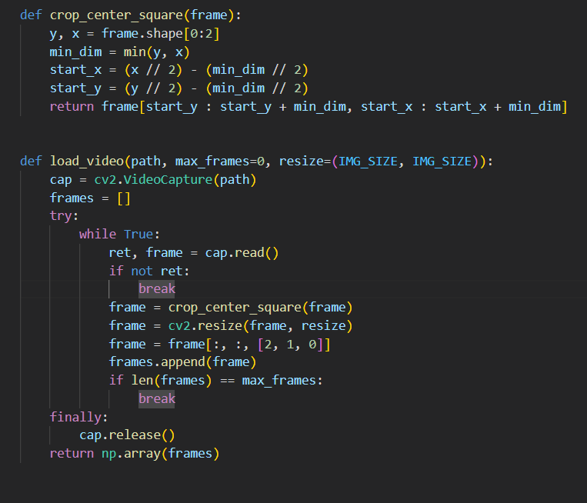
SAMPLE CODE
16

Slide 17
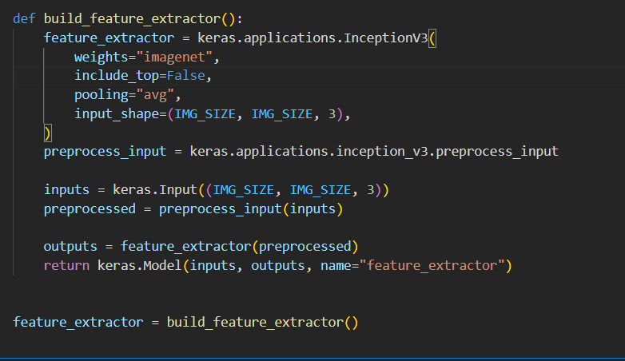
SAMPLE CODE
17

Slide 18
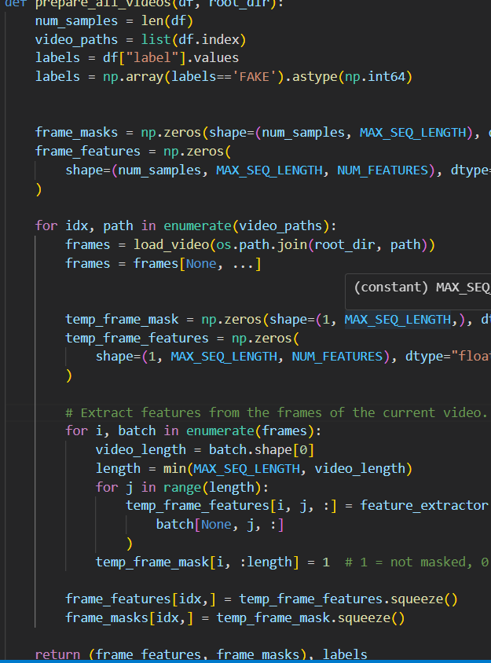
SAMPLE CODE
18

Slide 19
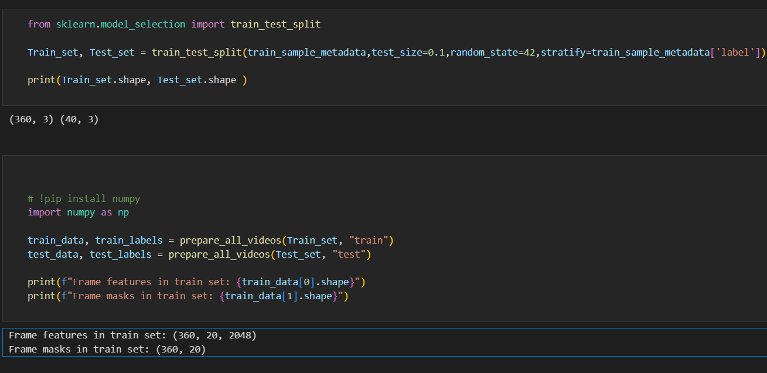
SAMPLE CODE
19

Slide 20
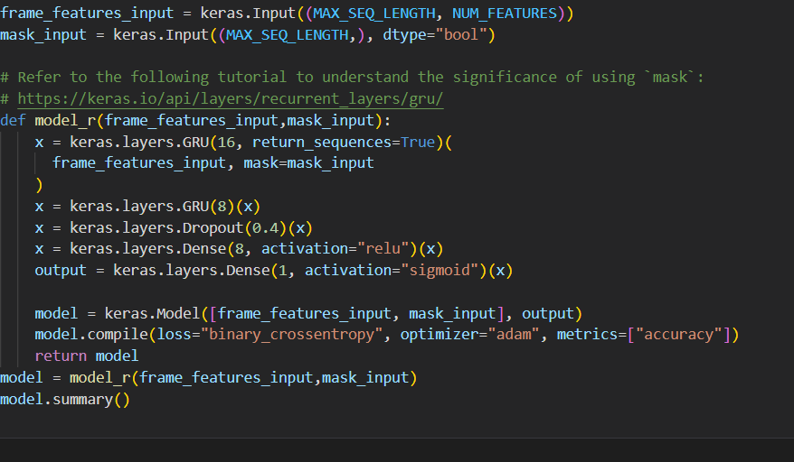
SAMPLE CODE
20

Slide 21
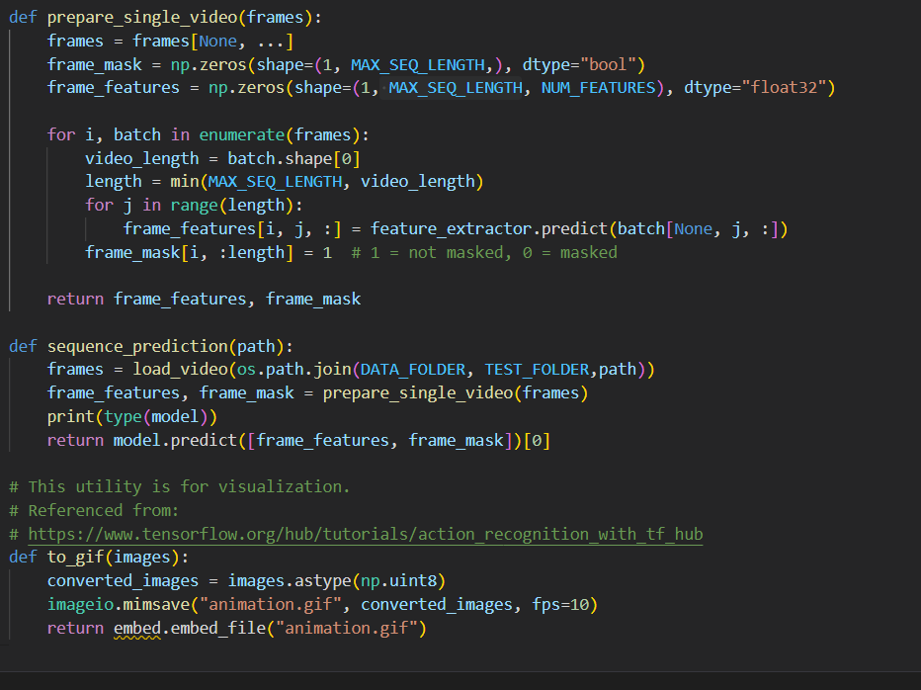
SAMPLE CODE
21

Slide 22
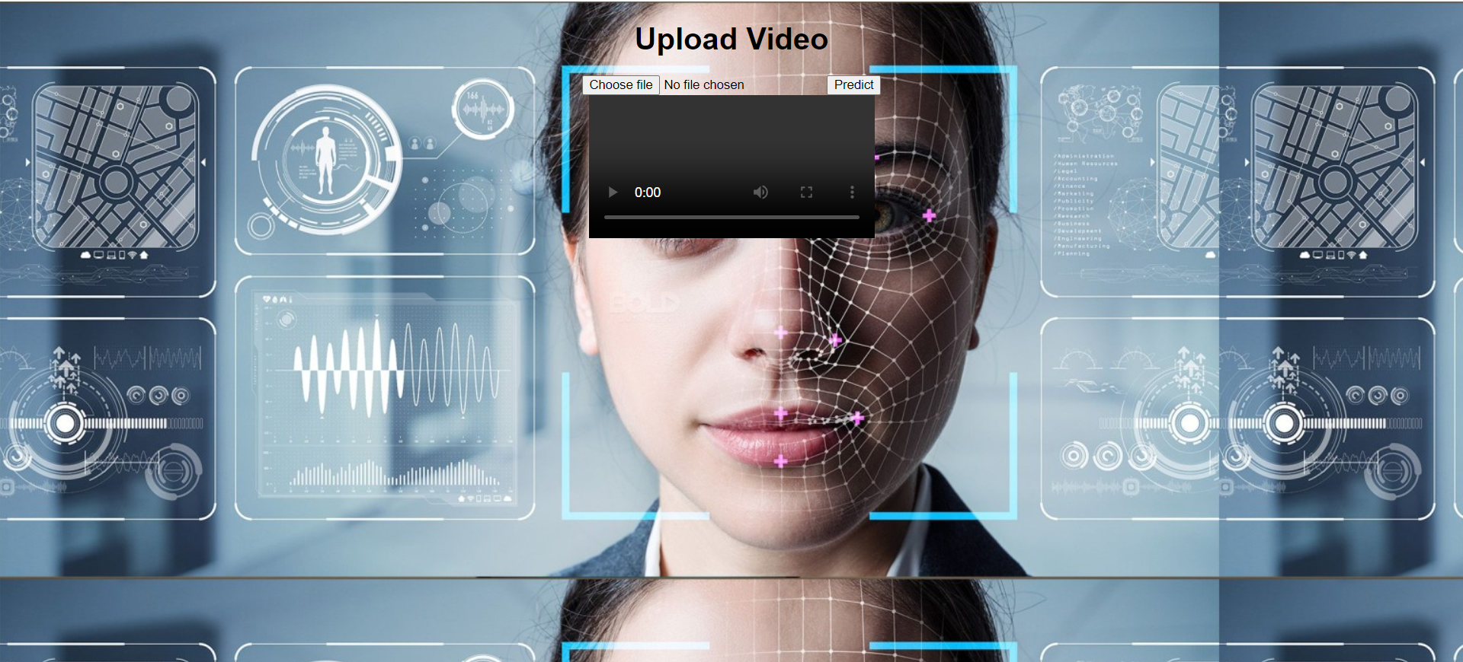
WEBPAGE PREVIEW
22

Slide 23
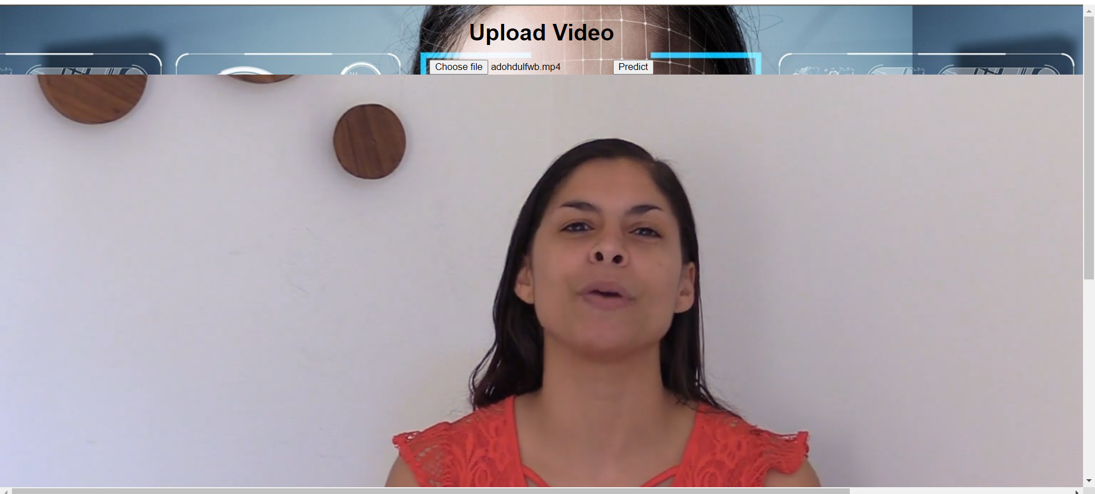
UPLOADED PAGE
23

Slide 24
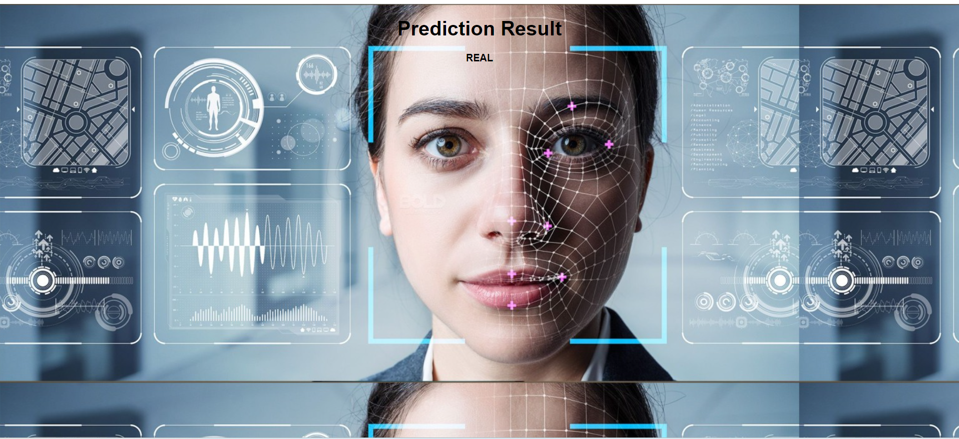
OUTPUT SCREEN
24

Slide 25
CONCLUSION
In this project, a deep learning solution is developed for the detection of deepfake videos. By harnessing the power of neural networks, specifically Gated Recurrent Units (GRUs) and pre-trained convolutional models like InceptionV3, a robust system is created capable of identifying manipulated videos. The GRU model achieves 80% accuracy in classifying videos as real or manipulated.
25

Slide 26
FUTURE SCOPE
There is always a scope for enhancements in any developed system, especially when the project build using latest trending technology and has a good scope in future.
Currently only Face Deep Fakes are being detected by the algorithm , but the algorithm can be enhanced in detecting full body deep fakes.
26

Slide 27
REFERENCES
Tewari, A., Zollhoefer, M., Bernard, F., Garrido, P., Kim, H., Perez, P., and Theobalt, C. (2018).High-delity monocular face reconstruction based on an unsupervised model-based face autoencoder.IEEE Transactions on Pattern Analysis and Machine Intelligence.
Lyu, S. (2018, August 29). Detecting deepfake videos in the blink of an eye.Retrievedfrom http://theconversation.com/detecting-deepfake-videos-in-the-blink-of-an-eye-101072
Rossler, A., Cozzolino, D., Verdoliva, L., Riess, C., Thies, J. and Nießner, M. (2019) Faceforensics++: Learning to Detect Manipulated Facial Images. Proceedings of the IEEE/CVF International Conference on Computer Vision, Seoul, 27-28 October 2019, 1-11. https://doi.org/10.1109/ICCV.2019.00009
Westerlund, M. (2019) The Emergence of Deepfake Technology: A Review. Technology Innovation Management Review, 9, 40-53. https://doi.org/10.22215/timreview/1282
27

Slide 28
THANK YOU

